Slide 1
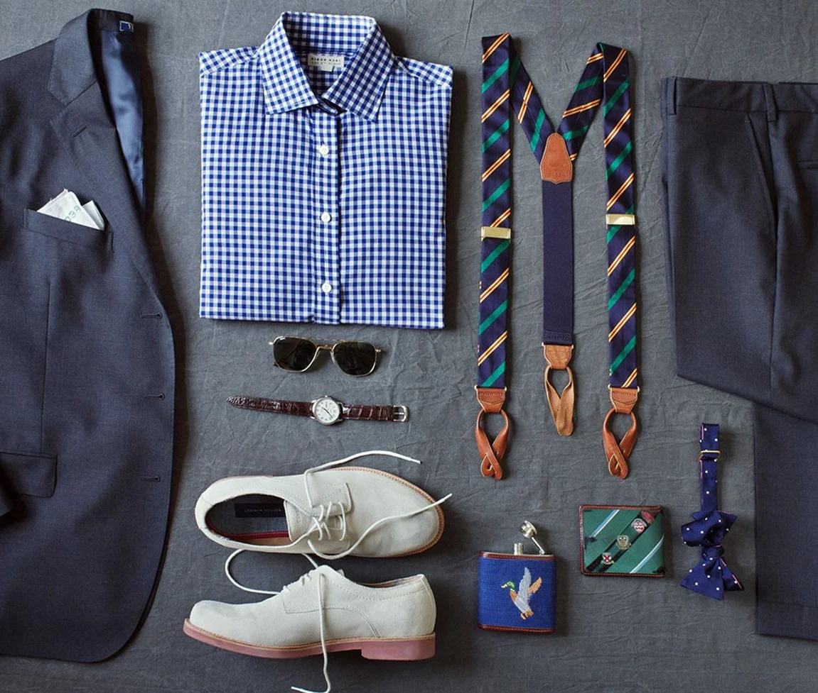
AI BASED VIRTUAL CLOTHING TRY ON
“Machine Intelligence is the last invention that humanity will ever need to make”
-Nick Bostrom

Slide 2

Problem statement
From the consumer and brand point of view, digital fashion is a big hit. This is because consumers can try it on before actually buying the item.
Soon customers will shop for clothes online by clicking on a fashion item and uploading a picture of themselves. The site will send you back the picture with you wearing the clothing item. This will ultimately lead to the digitalization retail industry.
Therefore, it is important for brands to have a virtual fashion library. This saves brands time, and money, while also being innovative. As we can see the digitalization of the retail industry to grow more and more soon.

Slide 3

Innovation
Customization and styling options: Users can adjust fit, colors, and patterns, and experiment with accessories for personalized interactions.
Experience the future of fashion with our revolutionary AI-based virtual clothing try-on technology, providing users with a realistic and personalized virtual fitting room to try on clothes without the need for a physical try-on.
Accurate fit prediction: AI algorithm predicts garment fit based on the user's body measurements, reducing sizing issues and returns.
Integration with e-commerce platforms: Seamless integration with online retailers' platforms for direct virtual try-on.

Slide 4

TECHNICAL Backbone
Computer Vision: Our system utilizes computer vision to accurately analyze and process images, enabling precise virtual clothing try-on experiences.
Machine Learning: Through advanced machine learning algorithms, our solution learns and predicts how clothing items will fit and look on different body types, ensuring realistic and personalized virtual try-on.
Fabric Simulation: Our technology replicates the behavior of real fabrics, such as drapes and textures, creating an authentic and lifelike virtual garment try-on experience.
Real-time Rendering: With cutting-edge rendering techniques, our system provides high-quality and real-time visualizations of virtual try-ons, ensuring a realistic representation of clothing items.
Seamless Integration: Our solution seamlessly integrates with e-commerce platforms, allowing customers to try on clothing items directly from their favorite brands' websites or applications, streamlining the shopping process.

Slide 5

BUSINESS USE CASE
Empowering Indian Fashion Retail: AI-based virtual try-on technology revolutionizes the industry, empowering retailers to enhance customer experience and drive growth.
Bridging Online-Offline Gap: Virtual try-on brings the convenience of online shopping to Indian consumers, enabling confident purchase decisions from home.
Enhancing Accessibility and Inclusivity: Virtual try-on caters to diverse body types, making fashion more accessible and inclusive for all in India.
Boosting Local Brands: AI-powered try-on enable Indian fashion brands to compete globally, showcasing unique designs and craftsmanship.
Data-Driven Insights: AI algorithms capture valuable data on Indian consumer preferences, trends, and body measurements, providing actionable insights for local designers and retailers.
Empowering Fashion Entrepreneurs: Virtual try-on opens doors for aspiring entrepreneurs to showcase designs and reach a broader customer base in India.

Slide 6

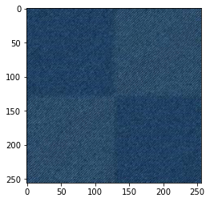
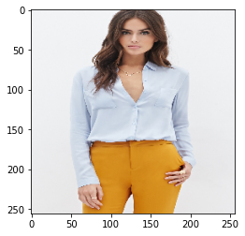
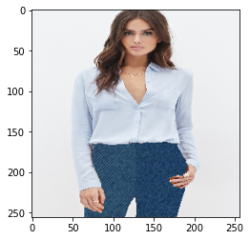
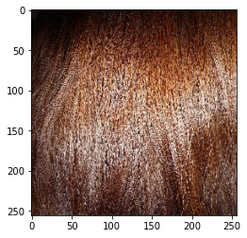
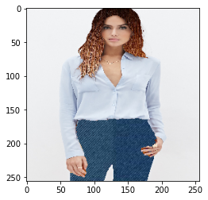
Let's try some cloths
Let's Try this for pant
Let's Try this Hair Color

Slide 7

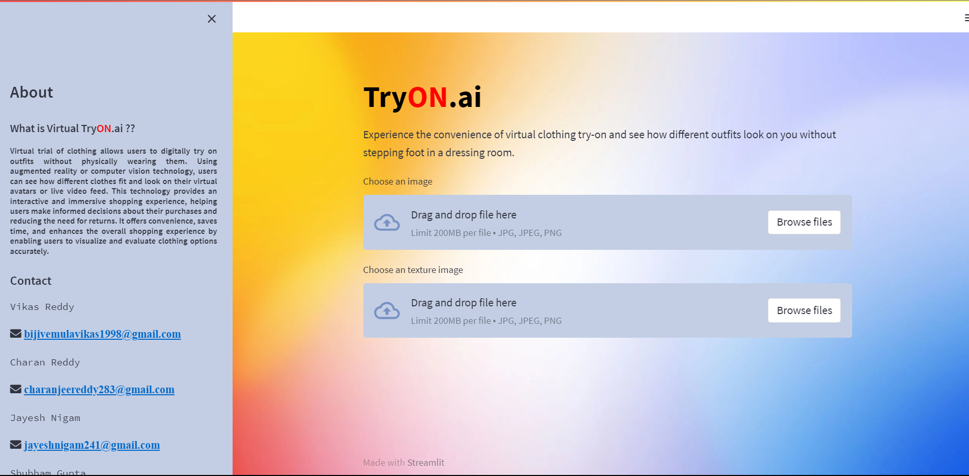
USER Interface

Slide 8
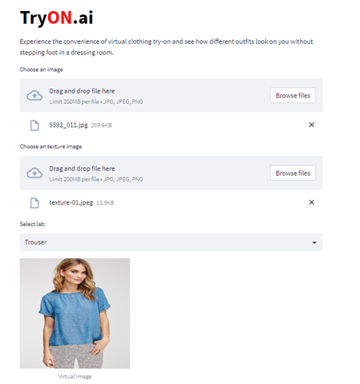
The user will initially select an image from the file browser.
In the second stage, the user must choose a texture image.
Once the input images are selected, the user simply needs to choose the lab
Within the lab, the user will have the option to adjust various parameters such as shirt, trousers, ornaments, hat, hair, face, and skin.
Based on the selection of lab user will be able to see an output image.

Slide 9
Thank You
Team: Possible-I’m
Vikas Reddy
Charan Reddy
Shubham Gupta
Jayesh Nikam

